Slide 1

Probability
Santosh Chhatkuli

Slide 2
The following are key benefits of knowing probability of events:
Better decision making: A company launching a new product can assess the probability of success or failure to decide whether to proceed.
Risk management: Insurance companies use probabilities to estimate risks (e.g., accidents, health issues) and set premiums
Optimum renounce allocation: Hospitals can predict patient inflow probabilities and allocate resources like beds, staff, and equipment efficiently.
Predicting future outcome: Weather forecasts rely on probabilities (e.g., 70% chance of rain) to guide activities like farming, travel, or outdoor events.
Improved Strategy in Games or Competitions: In poker or chess, players calculate probabilities to decide moves that maximize winning chances.
Understanding Randomness and Patterns: Probability explains phenomena like lottery wins, genetic traits, or stock market fluctuations.
Enhanced Business Forecasting: Businesses predict customer behavior (e.g., probability of repeat purchases) to tailor marketing strategies.
Safety and Reliability: Engineers use probabilities to assess the likelihood of system failures (e.g., bridges, airplanes).
Efficient Experimentation and Testing: In drug trials, probabilities help determine the effectiveness of a new medication.
Policy and Public Planning: Governments estimate the probability of natural disasters (e.g., earthquakes, floods) to plan emergency responses.

Slide 3
Terminology used in probability
Probability: Probability is a numerical measure of the likelihood or chance of a specific event occurring, expressed as a value between 0 and 1. A probability of 0 indicates that the event is impossible, while a probability of 1 indicates that the event is certain.
Random Experiment or Probability Experiment or Statistical Experiment: It is the chance process that leads to well defined result called outcomes.
Outcomes: An outcome is a single possible result of an experiment or random process.
Trial: A single performance of a random experiment is called a trial.
Event: An event is a set of one or more outcomes that share a common property. It is a subset of the sample space.
Sample Space: It is the set of all possible outcomes of a random experiment. It is denoted by symbol ‘S’

Slide 4

Example of sample space
Random Experiment | Sample Space
Tossing two coins simultaneously | S = {HH, HT, TH, TT}
Rolling a dice | S = { }
Blood Typing | S = {A, B, O, AB}
Result of diagnostic test | S = { positive, negative}
No. of goals in the match | S = {0, 1, 2, 3, ….}
Entrance score of students (Qualifying mark is 40 suppose) | S = {40, 40.1, …., 99.9, 100}
Browsing time in minutes per visit | S = {0, 0.1, …, 1, 1.1, …}

Slide 5
Types of Events
Sure Event: An event is said to sure if its occurrence is 100 % sure. Prob (sure event) = 1
Impossible Event: An event is said to be impossible if it can never occur. Prob (impossible event) = 0
Simple Event: An event which can’t be decomposed into two or more different simple events. It is one event. A simple event is an event that consists of a single outcome in the sample space.
Compound Event: An event is said to be compound if it consists of two or more simple events. A compound event is an event that consists of two or more outcomes in the sample space. The probability of a compound event is the sum of the probabilities of all the individual outcomes that make up the event.
Example:
(a) The event "rolling an even number" ({2,4,6} is a compound event
(b) The event of getting S = 7 (sum of number appearing in the dice) in rolling two dice.
Events
Simple Events
Compound Events
Mutually Exclusive Events
Equally Likely Events
Independent Events
Exhaustive Events
Dependent Events

Slide 6
5. Mutually Exclusive Events: Two or more events are called mutually exclusive if they can’t occur together.
Example 1: Tossing a coin
Event H = Getting a head
Event T = Getting a tail
Example 2: Randomly selecting a person
Event S = A person is smoker
Event N = A person is non-smoker
Example 3: Randomly selecting a person
Event D = A person is drinker
Event S = A person is smoker
Example 4: Result of exam
Event P = Passing an exam
Event F = Failing an exam
Example 5: Lab test of blood sample
Event P = Test result is positive
Event N = Test result is negative
Example 6: Applying for two jobs
Event E1: Selecting in the first job
Event E2: Selecting in the second job
Example 7: Weather
Even E1: a rainy day
Event E2: a cloudy day
Example 7: Skill of job applicant
Event C = Knows C programming
Event P = Knows Python
Event J = Knows Java

Slide 7






6. Equally Likely Events: Events are equally likely if they have same chance of happening.
Example 1: Suppose there are 48 students in a class of IT students, out of them there are 32 male students and 16 female students.
Prob (male student) = 32/48 = 0.67
Event of a student being male and female are not equally likely
Prob (female student) = 16/48 = 0.33
Example 2: Rolling a dice
Events are equally likely.
Outcome
Probability | 1/6 | 1/6 | 1/6 | 1/6 | 1/6 | 1/6
This Photo by Unknown Author is licensed under CC BY-SA
This Photo by Unknown Author is licensed under CC BY-SA
This Photo by Unknown Author is licensed under CC BY-SA
This Photo by Unknown Author is licensed under CC BY-SA
This Photo by Unknown Author is licensed under CC BY-SA
This Photo by Unknown Author is licensed under CC BY-SA

Slide 8
7. Dependent / Independent Events
Several events are said to be independent if the occurrence of one event doesn’t affect the outcome of other.
If the occurrence of one event is dependent on or affected by the occurrence of some other event the events are called dependent.
Example 1: Tossing a coin
Event H = Getting a head
Event T = Getting a tail
These two events are independent of each other
Example 2: Suppose a survey was conducted and among many questions two questions that were asked are: what is your gender? and Do you enjoy shopping? Suppose we have following result.
Prob (Yes) = 145/250 = 0.58 or 58 % =1/1.72
Prob (No) = 105/250 = 0.42 or 42 % or 1/2.38
Prob (Yes/Male) = 25/100 = 0.25 or 25 %
Prob (Yes/Female) = 120 / 150 = 0.8 or 80 %
Gender | Enjoy Shopping |  | Total
 | Yes | No
Male | 25 | 75 | 100
Female | 120 | 30 | 150
Total | 145 | 105 | n = 250

Slide 9
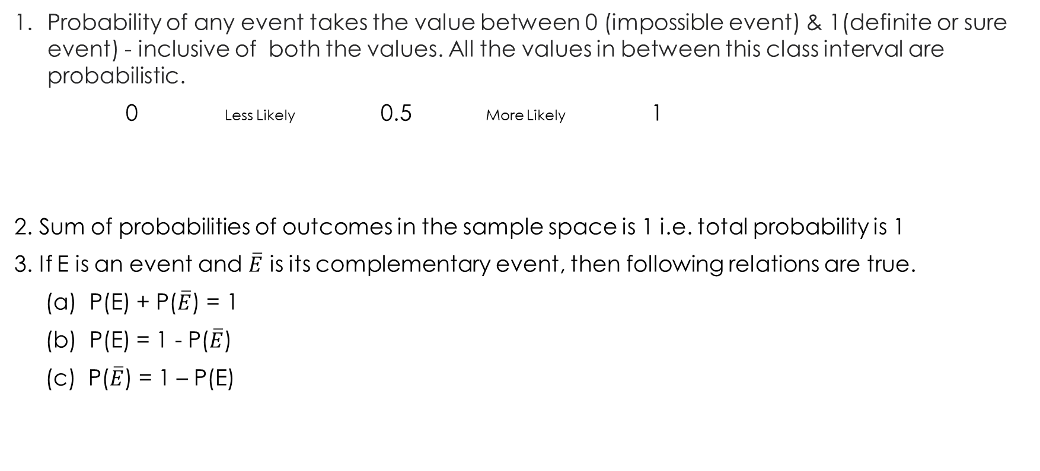
Basic rule of probability
Probability of any event takes the value between 0 (impossible event) & 1(definite or sure event) - inclusive of both the values. All the values in between this class interval are probabilistic.
0 Less Likely 0.5 More Likely 1
2. Sum of probabilities of outcomes in the sample space is 1 i.e. total probability is 1
3. If E is an event and $\overline{E}$ is its complementary event, then following relations are true.
(a) P(E) + P($\overline{E}$) = 1
(b) P(E) = 1 - P($\overline{E}$)
(c) P($\overline{E}$) = 1 – P(E)
Impossible event
Sure Event

Slide 10
Approaches in probability
There are three approaches in defining a probability of an event.
Classical or Priori Approach
Relative Frequency or Empirical Approach
Subjective Approach

Slide 11
Classical definition of probability
If an experiment can produce ‘N’ exhaustive and mutually exclusive outcome, all of which are equally likely and if ‘n’ of these outcome are favorable to happening of event E, the probability of happening of E is given by,
Notes:
Classical probability uses sample space to determine the numerical probability that an event will happen.
It assumes that all outcomes in the sample space are equally likely to occur.
Classical probability is also called priori probability because we can state the probability of event in advance (a priori) without performing an experiment, i.e. probability of success is based on prior knowledge of the process involved.
This approach of probability is useful when we deal with card game, dice games, coin tossing etc.

Slide 12
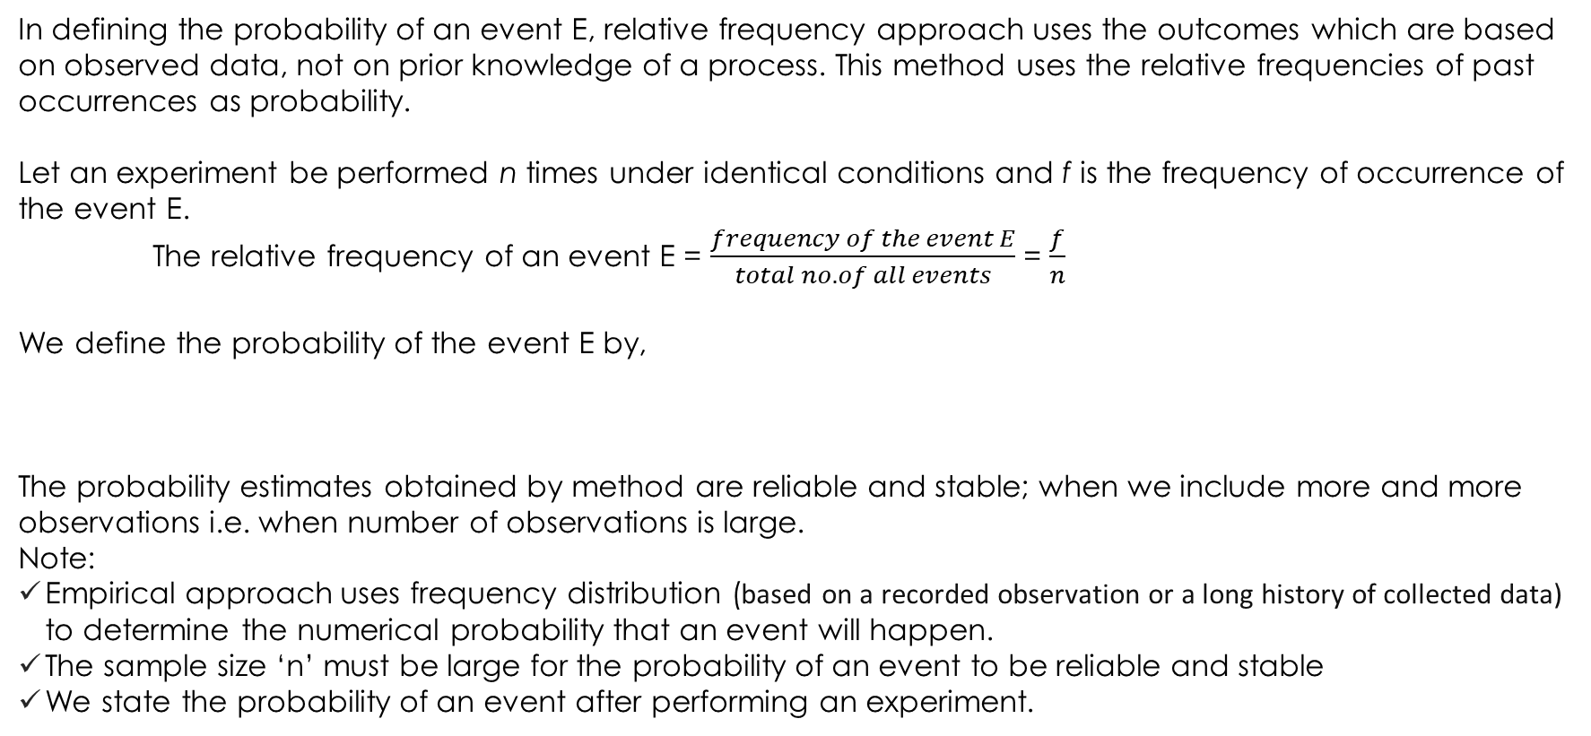
Empirical definition of probability
In defining the probability of an event E, relative frequency approach uses the outcomes which are based on observed data, not on prior knowledge of a process. This method uses the relative frequencies of past occurrences as probability.
Let an experiment be performed n times under identical conditions and f is the frequency of occurrence of the event E.
The relative frequency of an event E = $\frac{frequency of the event E}{total no. of all events}$ = $\frac{f}{n}$
We define the probability of the event E by,
The probability estimates obtained by method are reliable and stable; when we include more and more observations i.e. when number of observations is large.
Note:
Empirical approach uses frequency distribution (based on a recorded observation or a long history of collected data) to determine the numerical probability that an event will happen.
The sample size ‘n’ must be large for the probability of an event to be reliable and stable
We state the probability of an event after performing an experiment.

Slide 13
Subjective Probability
Subjective probability is a type of probability derived from an individual's personal judgment or own experience about whether a specific outcome is likely to occur. It contains no formal calculations and only reflects the subject's opinions and past experience.
This approach is especially used when we do not have historical data relating to the event.
Assessment of probability is based on:
Individual past experience
Personal opinion or belief (highly flexible, even in terms of one individual’s belief)
Analysis of the situation
Knowledge or expertise in the field

Slide 14
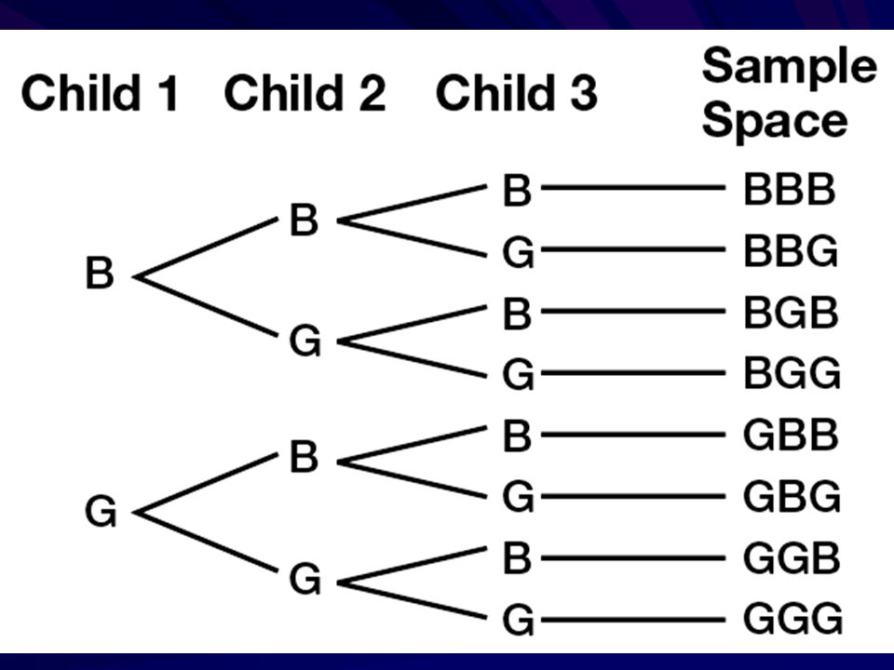
Example 1: In a family of three children (no twins, triplets), find the following probabilities.
All children are girls (b) All children are boys (c) All girls or all boys (d) Exactly two boys
(e) At least one child of each gender (f) gender in alternative form
Solution:
Total no. of cases in the sample space = 2^3 = 8
Sample Space = {BBB, BBG, BGB, BGG, GBB, GBG, GGB, GGG}

Slide 15
Solution:
(a) P (all girls) = No. of cases favorable to the Event / total no. of cases in sample space = n/N = 1/8 = 0.125 = 12.5
(b) P (all boys) = No. of cases favorable to the Event / total no. of cases in sample space = n/N = 1/8 = 0.125 = 12.5
(c) P (all girls or all boys) = Favorable cases / Total cases = n/N = 2 / 8 =1/4 = 0.25 = 25 %
(d) P (exactly two boys) = Favorable cases / Total cases = 3 / 8
= 0.375 = 37.5 %
(e) P (at least one child of each gender) = 6 / 8 = 3 / 4 = 0.75 = 75 %
(f) P (gender in alternative form) = 2 / 8 = 1 / 4 = 0.25 = 25 %

Slide 16
Example 2:
Hospital records of maternity patients who stayed in the hospitals for the number of days is shown in the following distribution.
Find these probabilities:
A patient stayed exactly 5 days
P(X = 5) = P(5 days) = f / n = 56 / 130 = 0.4307
A patient stayed less than 6 days
P(X < 6) = P(less than 6 days) = f / n = (15 + 32 + 56) / 130 = 103 / 130 = 0.7923
A patient stayed at most 4 days
P(at most 4 days) = f / n = (15 + 32) / 130 = 47 / 130 = 0.3615
A patient stayed at least 5 days
P(at least 5 days) = (56 + 19 + 8) / 130 = 83 / 130 = 0.6385
A patient stayed between 4 to 6 days inclusive
P(4 to 6 days) = (32 + 56 + 19) / 130 = 107 / 130 = 0.8231
No. of days stayed (X) | 3 | 4 | 5 | 6 | 7 | Total
Frequency (f) | 15 | 32 | 56 | 19 | 8 | 130

Slide 17
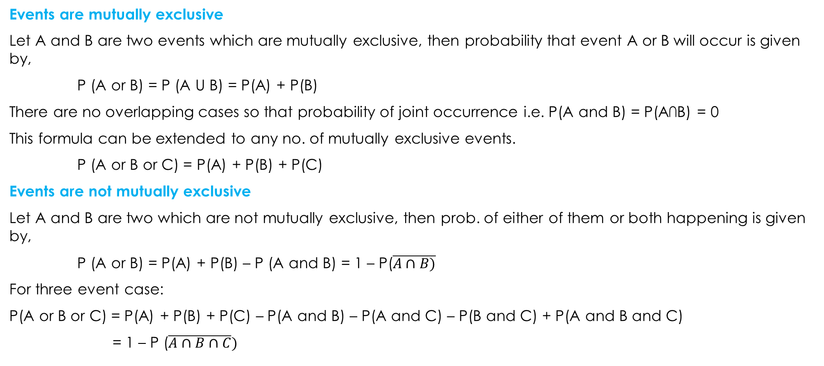
Additional Rule of Probability
Events are mutually exclusive
Let A and B are two events which are mutually exclusive, then probability that event A or B will occur is given by,
P (A or B) = P (A U B) = P(A) + P(B)
There are no overlapping cases so that probability of joint occurrence i.e. P(A and B) = P(A∩B) = 0
This formula can be extended to any no. of mutually exclusive events.
P (A or B or C) = P(A) + P(B) + P(C)
Events are not mutually exclusive
Let A and B are two which are not mutually exclusive, then prob. of either of them or both happening is given by,
P (A or B) = P(A) + P(B) – P (A and B) = 1 – P($\overline{A∩B)}$
For three event case:
P(A or B or C) = P(A) + P(B) + P(C) – P(A and B) – P(A and C) – P(B and C) + P(A and B and C)
= 1 – P ($\overline{A∩B∩C})$

Slide 18
Multiplicative rule of probability
Events are independent (Under statistical independence)
If A and B are two independent events, then probability of their simultaneous occurrence is given by,
P (A and B) = P (A ∩ B) = P(A) . P(B)
P (A and B and C) = P (A ∩ B ∩ C) = P(A) . P(B) . P(C)
Events are dependent (Under statistical dependence)
If A and B are two dependent events, then probability of their joint occurrence is given by,
P (A and B) = P (A ∩ B) = P(A) . P(B/A)
= P(B) . P(A/B)
Notation:
P(B/A) = Conditional probability of an event B given that event A has already occurred
or probability of event B given information about the occurrence of event A.
P (A/B) = Conditional probability of an event A given that event A has already occurred
or probability of event B given information about the occurrence of event B.

Slide 19
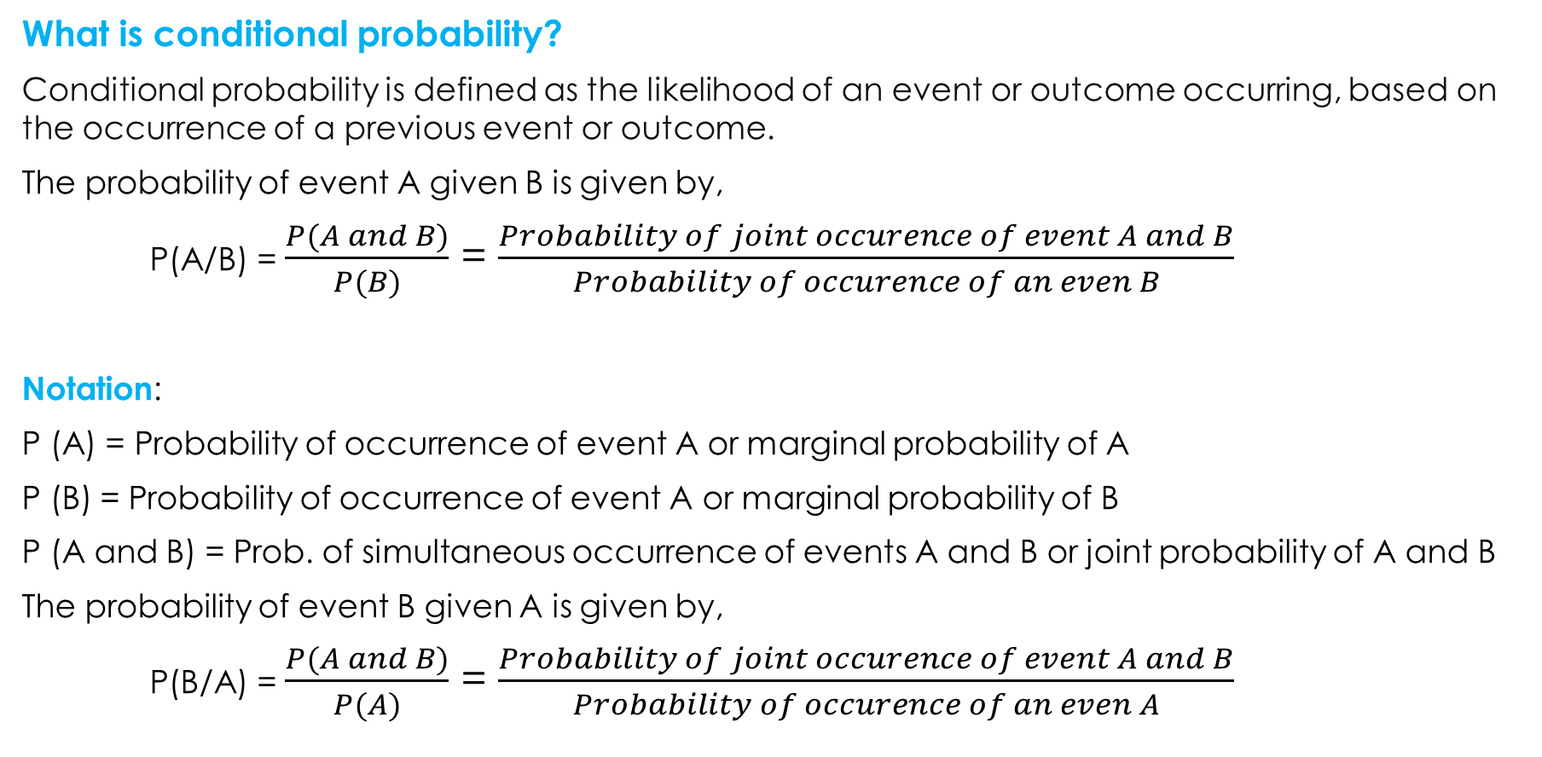
What is conditional probability?
Conditional probability is defined as the likelihood of an event or outcome occurring, based on the occurrence of a previous event or outcome.
The probability of event A given B is given by,
P(A/B) = $\frac{P(A and B)}{P(B)}$ = $\frac{Probability of joint occurence of event A and B}{Probability of occurence of an even B}$
Notation:
P (A) = Probability of occurrence of event A or marginal probability of A
P (B) = Probability of occurrence of event A or marginal probability of B
P (A and B) = Prob. of simultaneous occurrence of events A and B or joint probability of A and B
The probability of event B given A is given by,
P(B/A) = $\frac{P(A and B)}{P(A)}$ = $\frac{Probability of joint occurence of event A and B}{Probability of occurence of an even A}$

Slide 20
Example: One hundred students were surveyed about their preference between dogs and cats. The following two-way table displays data for the sample of students who responded to the survey.
In this sample, are the events "prefers dogs" and "prefers cats" mutually exclusive?
Find the probability that a randomly selected student prefers dogs.
Find the probability that a randomly selected student prefers dogs or is female.
Find the probability that a randomly selected student prefers cats given that he is male.
Are the event of ‘female’ independence of event ‘prefer dogs’?
Preference | Male | Female | Total
Prefers dogs | 120 | 65 | 185
Prefers cats | 70 | 110 | 180
No preference | 10 | 25 | 35
Total | 200 | 200 | n = 400

Slide 21
Solution:
Event D = Prefers dogs Event M = randomly selected student is a male
Event C = Prefers cats Event F = randomly selected student is a female
Events of ‘prefers dogs’ and ‘prefers cats’ are not mutually exclusive, because a same person may prefer both pets.
P(D) = f/n = 185/400 = 0.4625
P (D or F) = P(D) + P(F) - P (D and F) = 185/400 + 200/400 – 65/400 =
P (C/M) = P (C and M)/ P(M) = 70/400 / 200/400 =
Since P (D/M) = 120/200 = 0.6 and P(D/F) = 65/200 = 0.325. It means that male is twice as likely to prefer dog than female. Hence, preference of dog is dependent on gender.
Further,
P(F and D) = 65/400 = 0.1625
and
P(F) . P(D) = 200/400 x 185/400 = 0.23125
Hence, we can say event of student being female and preferring dog are not independent.

Slide 22
Example: In a survey conducted by a college both full time and part-time, students were asked how often they had visited the college’s tutoring center in the last two months. The results may be represented as follows:
What is the probability the student visited the tutoring center four or more times, given that the student is full time?
Suppose that a student is part-time. What is the probability that the student visited the tutoring center one or fewer times?
If the student visited the tutoring center four or more times, what is the probability he or she is a part-time student?
Types of students | Number of times students visited tutoring
 | One or fewer times | Two to three times | Four or more times | Total
Full time | 12 | 25 | 8 | 45
Part time | 2 | 5 | 6 | 13
Total | 14 | 30 | 14 | n = 58

Slide 23
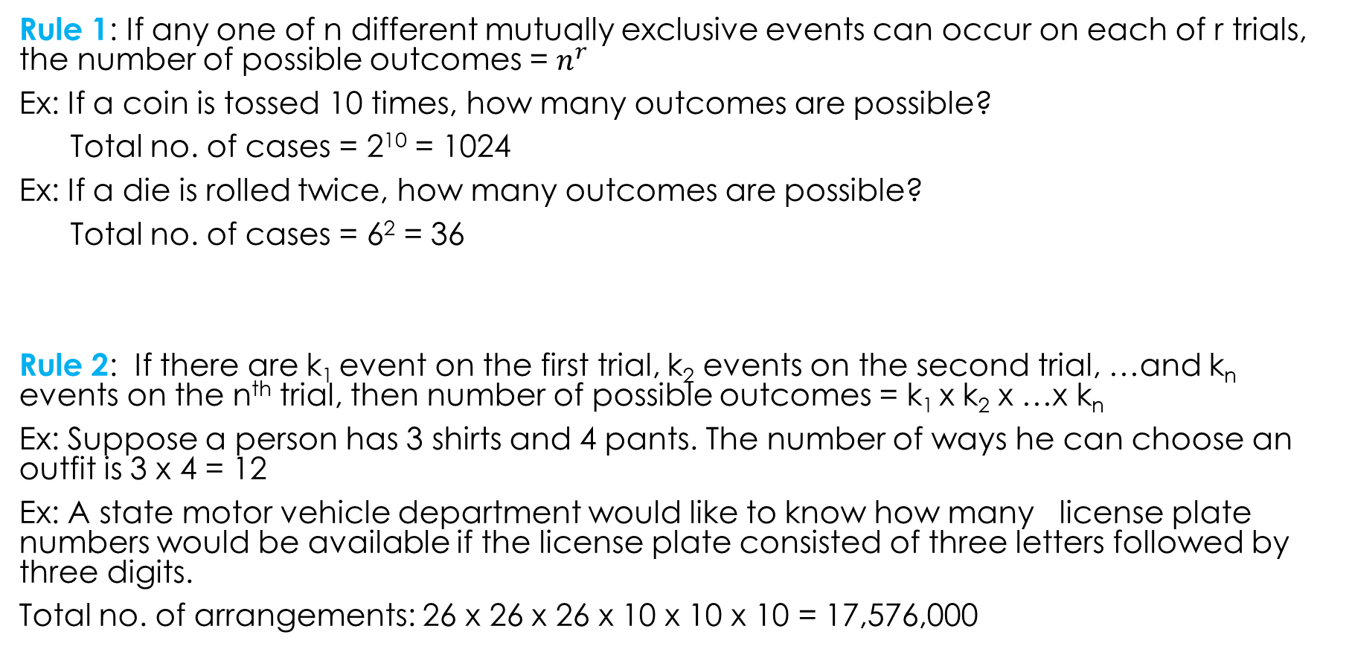
Rules of counting
Rule 1: If any one of n different mutually exclusive events can occur on each of r trials, the number of possible outcomes = $n^{r}$
Ex: If a coin is tossed 10 times, how many outcomes are possible?
Total no. of cases = 2¹⁰ = 1024
Ex: If a die is rolled twice, how many outcomes are possible?
Total no. of cases = 6² = 36
Rule 2: If there are k₁ event on the first trial, k₂ events on the second trial, …and k_{n} events on the n^{th} trial, then number of possible outcomes = k₁ x k₂ x …x k_{n}
Ex: Suppose a person has 3 shirts and 4 pants. The number of ways he can choose an outfit is 3 x 4 = 12
Ex: A state motor vehicle department would like to know how many license plate numbers would be available if the license plate consisted of three letters followed by three digits.
Total no. of arrangements: 26 x 26 x 26 x 10 x 10 x 10 = 17,576,000

Slide 24
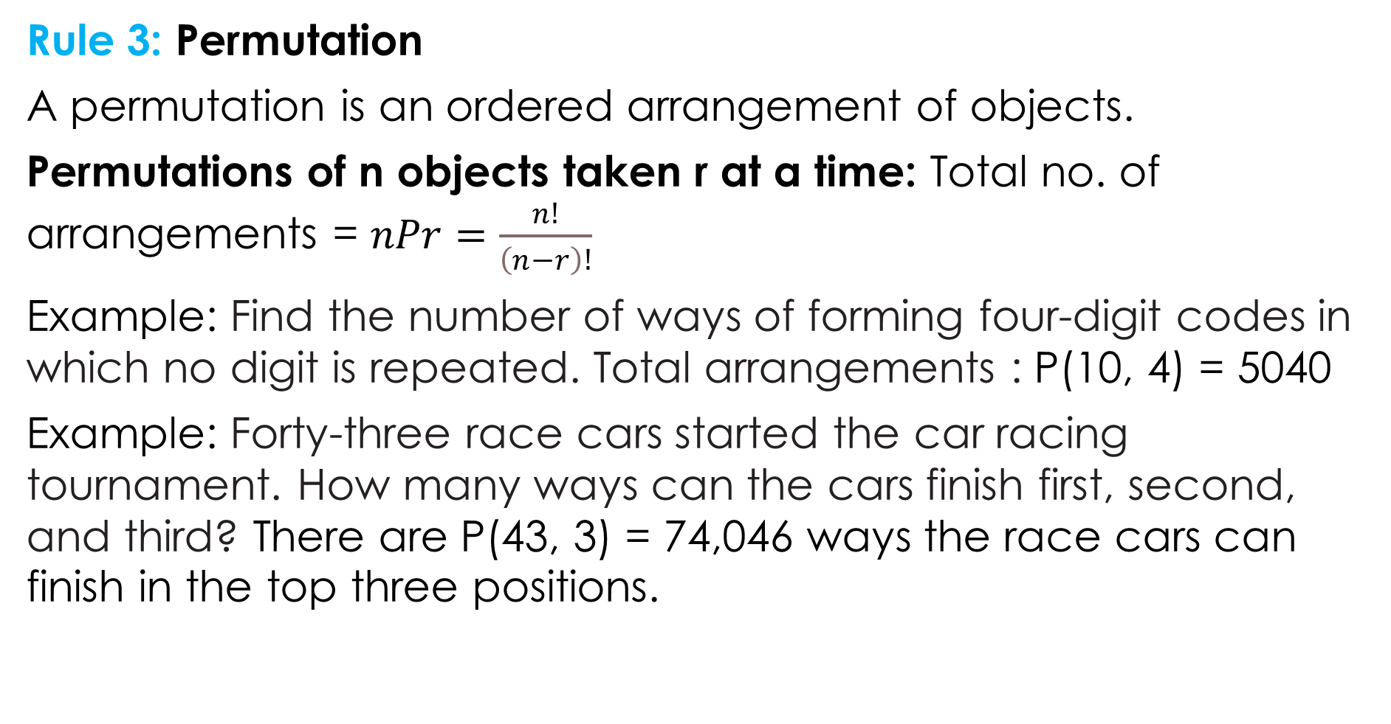
Rule 3: Permutation
A permutation is an ordered arrangement of objects.
Permutations of n objects taken r at a time: Total no. of arrangements = $nPr=\frac{n!}{\left(n−r\right)!}$
Example: Find the number of ways of forming four-digit codes in which no digit is repeated. Total arrangements : P(10, 4)​ = 5040
Example: Forty-three race cars started the car racing tournament. How many ways can the cars finish first, second, and third? There are P(43, 3) = 74,046 ways the race cars can finish in the top three positions.

Slide 25
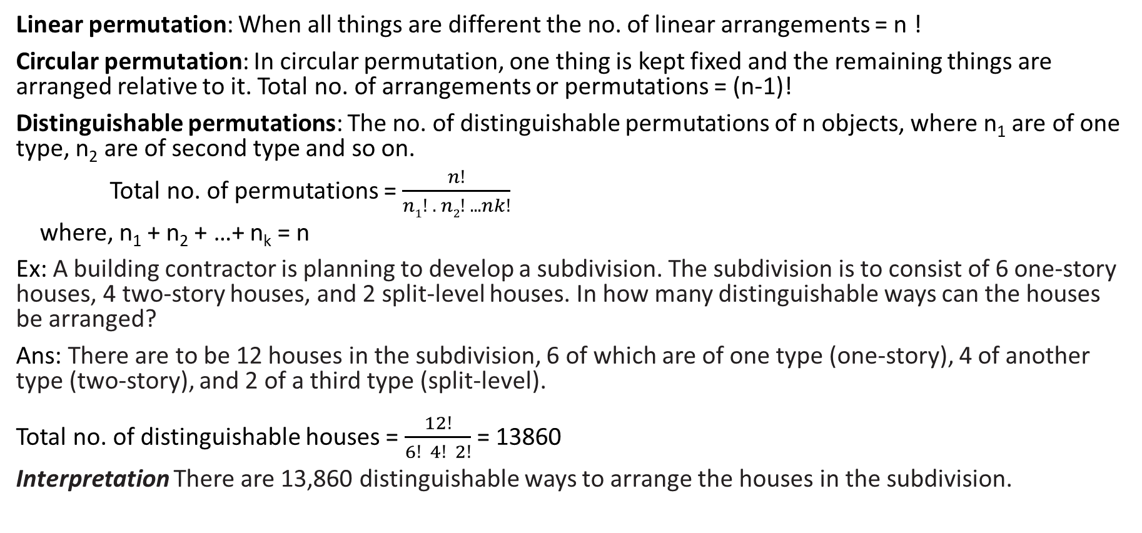
Other permutations
Linear permutation: When all things are different the no. of linear arrangements = n !
Circular permutation: In circular permutation, one thing is kept fixed and the remaining things are arranged relative to it. Total no. of arrangements or permutations = (n-1)!
Distinguishable permutations: The no. of distinguishable permutations of n objects, where n₁ are of one type, n₂ are of second type and so on.
Total no. of permutations = $\frac{n!}{n1! . n2! .. . nk!}$
where, n₁ + n₂ + …+ n_{k} = n
Ex: A building contractor is planning to develop a subdivision. The subdivision is to consist of 6 one-story houses, 4 two-story houses, and 2 split-level houses. In how many distinguishable ways can the houses be arranged?
Ans: There are to be 12 houses in the subdivision, 6 of which are of one type (one-story), 4 of another type (two-story), and 2 of a third type (split-level). Total no. of distinguishable houses = $\frac{12!}{6! 4! 2!}$ = 13860
Interpretation There are 13,860 distinguishable ways to arrange the houses in the subdivision.

Slide 26
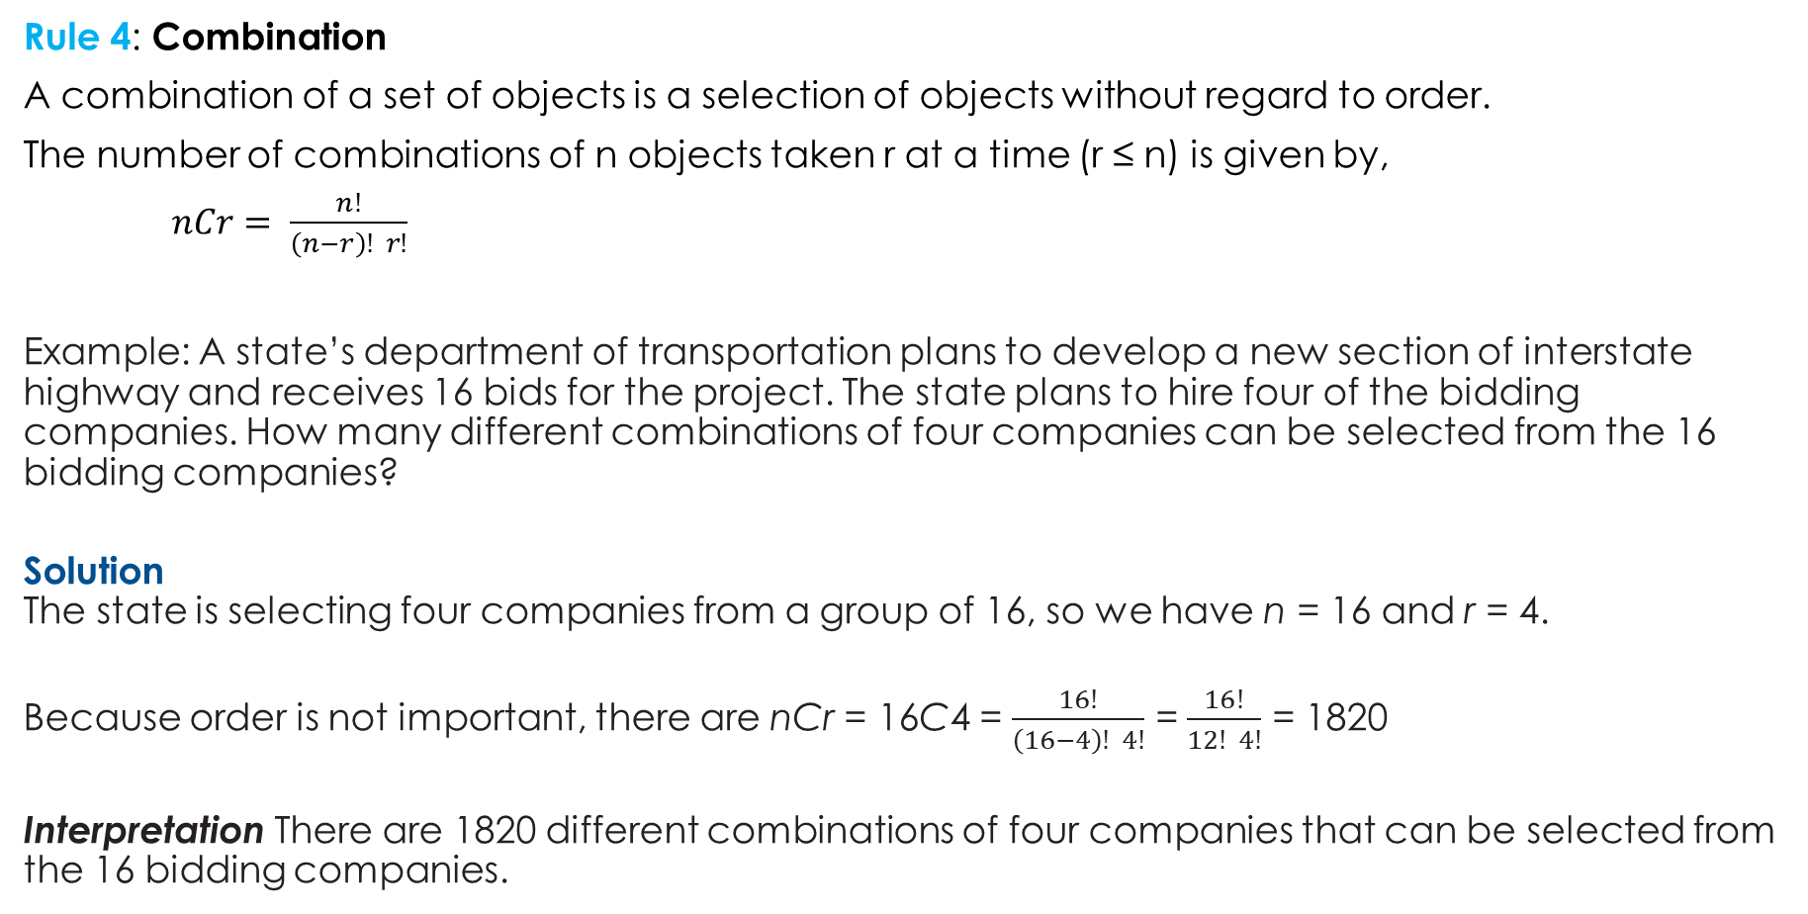
Rule 4: Combination
A combination of a set of objects is a selection of objects without regard to order.
The number of combinations of n objects taken r at a time (r ≤ n) is given by,
$nCr= \frac{n!}{\left(n−r\right)! r!}$
Example: A state’s department of transportation plans to develop a new section of interstate highway and receives 16 bids for the project. The state plans to hire four of the bidding companies. How many different combinations of four companies can be selected from the 16 bidding companies?
Solution The state is selecting four companies from a group of 16, so we have n = 16 and r = 4.
Because order is not important, there are nCr = 16C4 = $\frac{16!}{\left(16−4\right)! 4!}$ = $\frac{16!}{12! 4!}$ = 1820
Interpretation There are 1820 different combinations of four companies that can be selected from the 16 bidding companies.

Slide 27
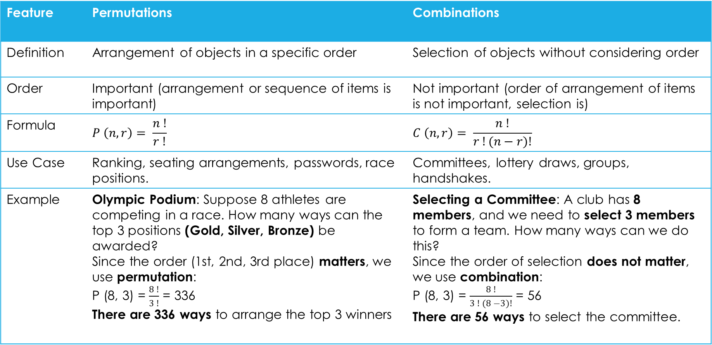
Difference between permutations and combinations
Feature | Permutations | Combinations
Definition | Arrangement of objects in a specific order | Selection of objects without considering order
Order | Important (arrangement or sequence of items is important) | Not important (order of arrangement of items is not important, selection is)
Formula | $$P \left(n, r\right)= \frac{n !}{r !}$$ | $$C \left(n, r\right)= \frac{n !}{r !(n−r)!}$$
Use Case | Ranking, seating arrangements, passwords, race positions. | Committees, lottery draws, groups, handshakes.
Example | Olympic Podium: Suppose 8 athletes are competing in a race. How many ways can the top 3 positions (Gold, Silver, Bronze) be awarded? Since the order (1st, 2nd, 3rd place) matters, we use permutation: P (8, 3) = $\frac{8 !}{3 !}$ = 336 There are 336 ways to arrange the top 3 winners | Selecting a Committee: A club has 8 members, and we need to select 3 members to form a team. How many ways can we do this? Since the order of selection does not matter, we use combination: P (8, 3) = $\frac{8 !}{3 ! (8 −3)!}$ = 56 There are 56 ways to select the committee.

